Slide 1


AGRICONNECT
Agriconnect
Team name : Synapse Quad

Slide 2
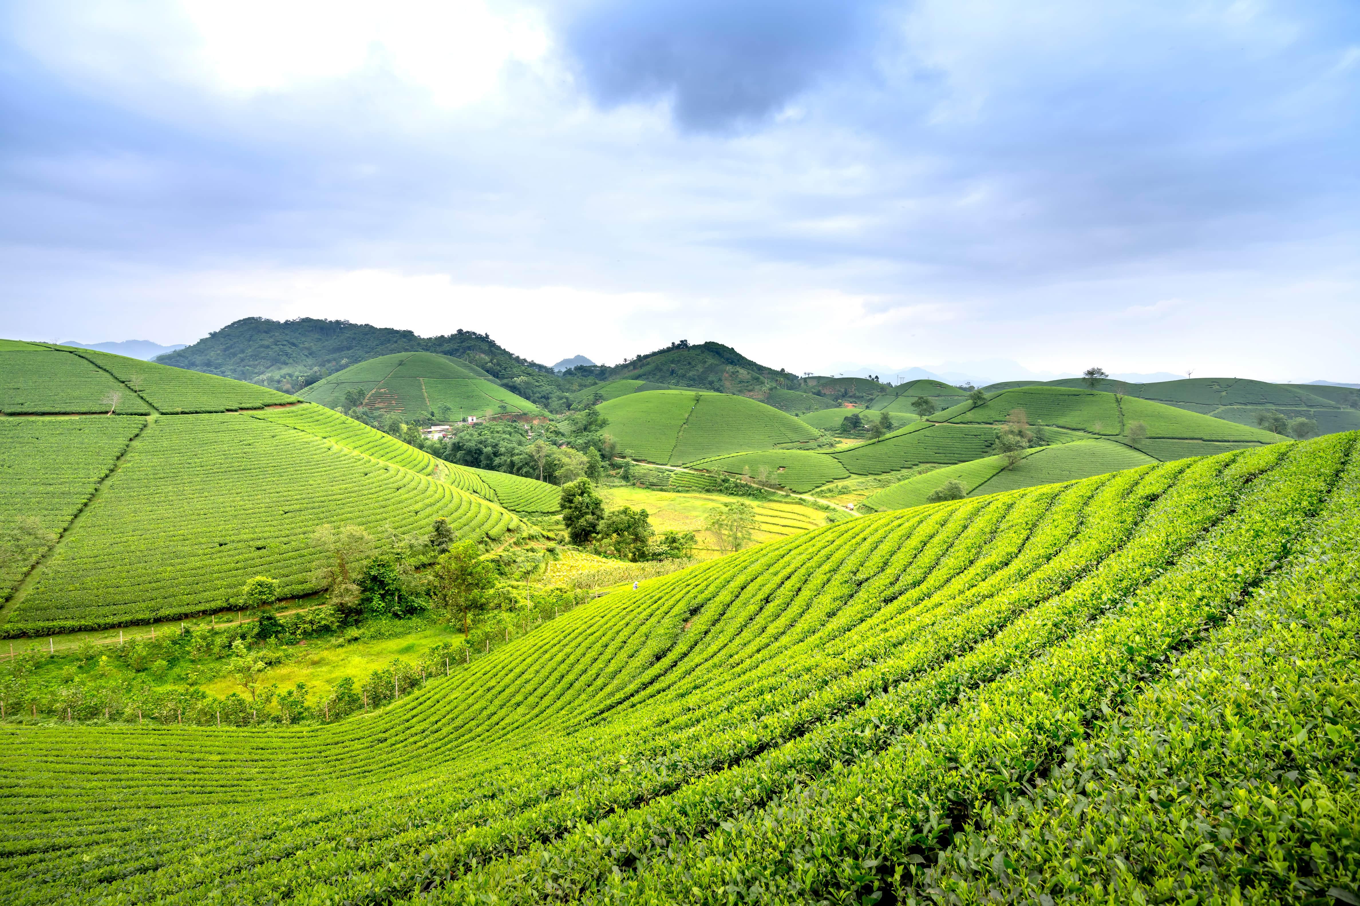
AGRICONNECT
Our Mission
Vision: To revolutionize agriculture with transparent, tech-driven solutions that empower farmers.
Mission: Provide secure transactions, AI-powered insights, and a direct-to-consumer marketplace for sustainable farming growth.

Slide 3
AGRICONNECT
Challenges Faced by Farmers:
Unfair pricing due to middlemen
Lack of access to real-time market insights
Financial insecurity and cash dependency
Limited digital literacy and advisory services
Problem Statement

Slide 4
AGRICONNECT
AgriConnect Solution
✅ Tech-Enabled Transparency: Blockchain for secure payments
✅ AI Smart Assistance: Voice-based chatbot in regional languages
✅ Direct Marketplace: Eliminating middlemen for better profits
✅ Data-Driven Insights: Market trends and weather forecasts
✅ Financial Inclusion: Secure digital payment options

Slide 5
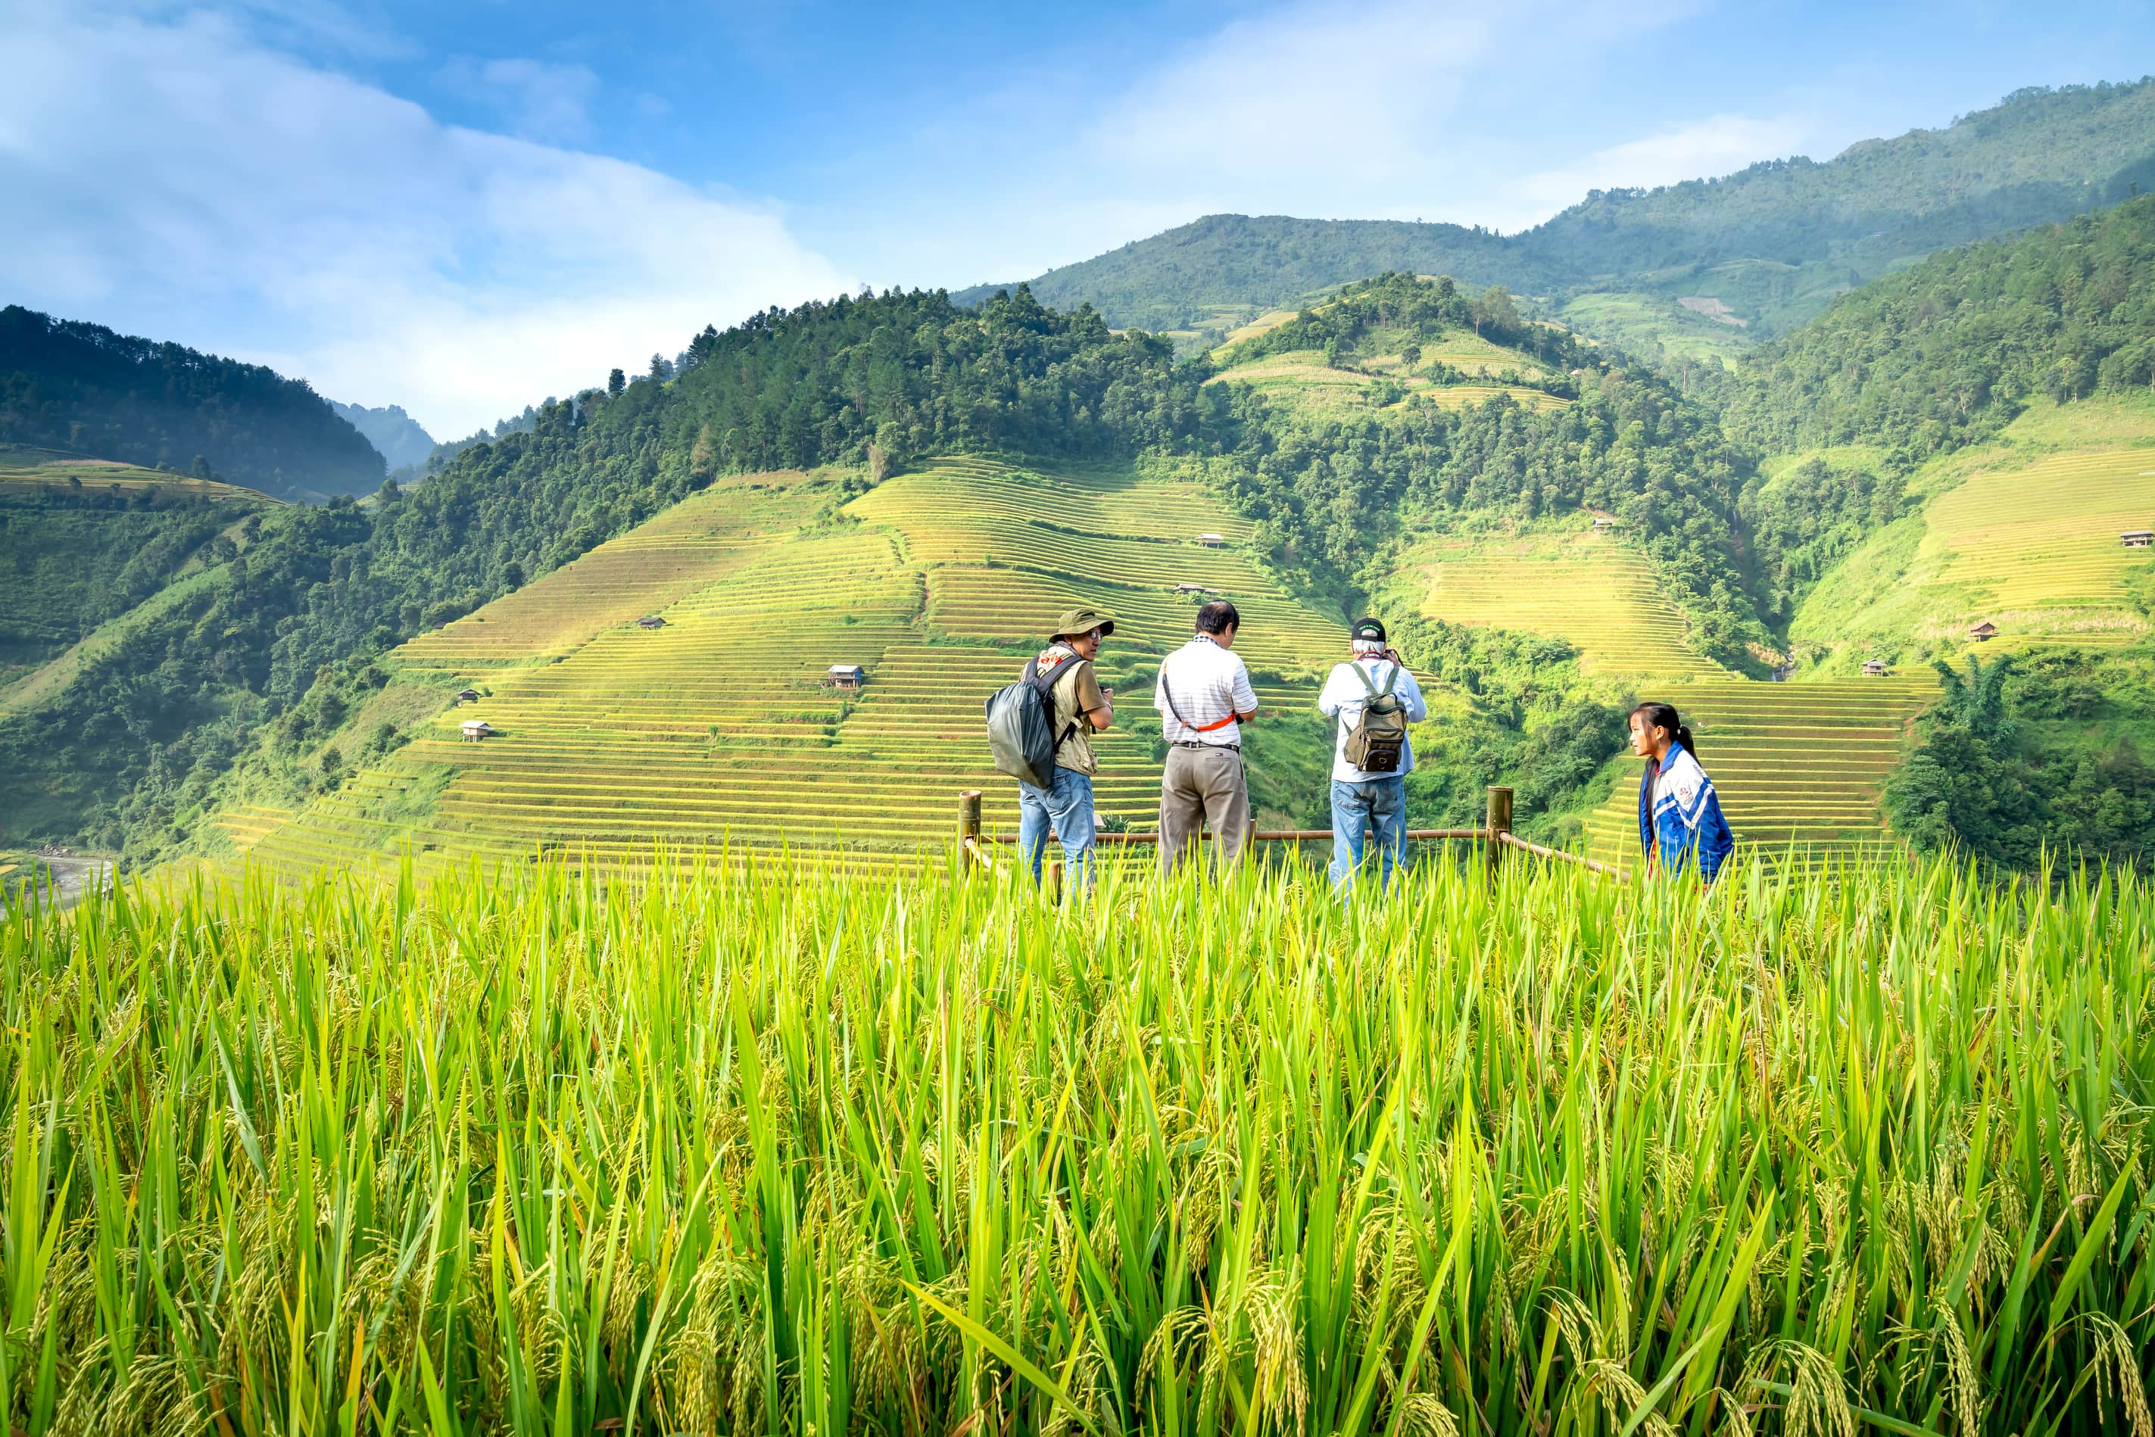
AGRICONNECT
Prototype Demonstration
🎯 Real-time weather & pricing updates
📱 Mobile-friendly, easy-to-use interface
🔗 Blockchain-based escrow transactions
🤖 AI-powered chatbot for farming guidance
⚡ Scalable for large user bases

Slide 6
AGRICONNECT
Business Model & Revenue Streams
Subscription plans for premium insights
Transaction fees on secure payments
Government and institutional partnerships
AI-powered advisory service packages

Slide 7
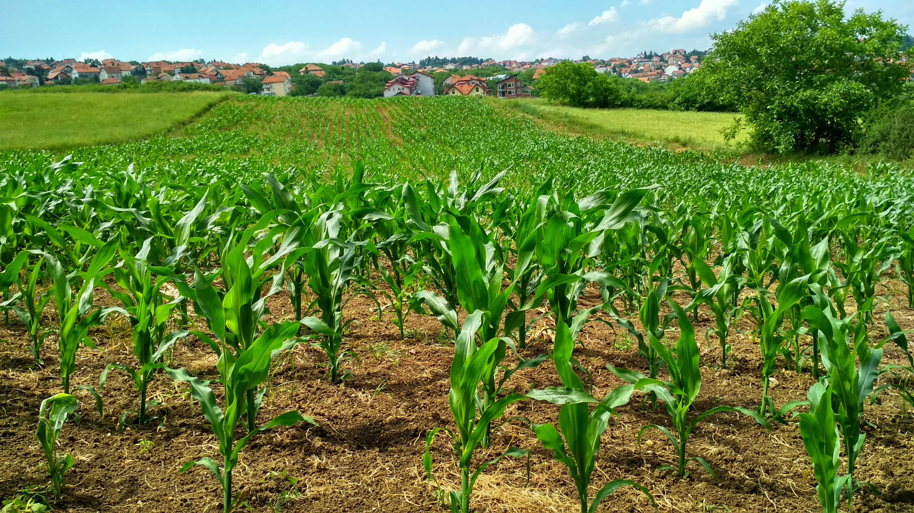

AGRICONNECT
Competitive Advantage
🔹 AI-Driven: (sitaa)Local language chatbot for easy access
🔹 Data-Backed Decisions: Market trends and pricing insights
🔹 User-Centric Design: Accessible for all literacy levels
Secure & Transparent: Blockchain ensures fair payments

Slide 8
AGRICONNECT
Partnerships & Future Growth
🌱 Planned Collaborations:
Government agencies for wider adoption
Agri-tech firms for additional insights
Financial institutions for better digital payment support
🚀 Next Steps:
Scaling up the prototype for wider adoption
Partnering with key stakeholders
Seeking funding and strategic investments
Call to Action

